Slide 1
Biomarker Discovery and Validation in Progressive
Supranuclear Palsy (PSP)
Biospecimen collection & processing

Slide 2
Overview
Specimen uniformity and quality
Site Equipment
Procedures
Kit Ordering
Sample Labels
Sample Collection and Processing
Shipping Closures
Contact Information

Slide 3
Specimen Uniformity and Quality
General Reminders

Slide 4
Specimen Uniformity and Quality
Most biomarkers are sensitive to time and temperature
Standardization of processing across sites is key
Reference the BioSEND Specimen Collection, Processing, and Shipment Manual as needed
Do not replace or supplement any kit components without first receiving approval from BioSEND/NINDS

Slide 5
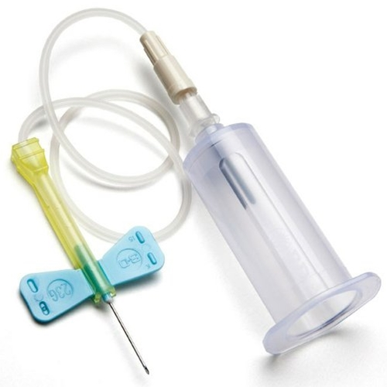
Site Equipment
Sites will need to supply the following items:
Phlebotomy
Gloves
Alcohol wipes
Butterfly needles
Tourniquet
Gauze pads
Bandages
Sharps bin and lid

Slide 6
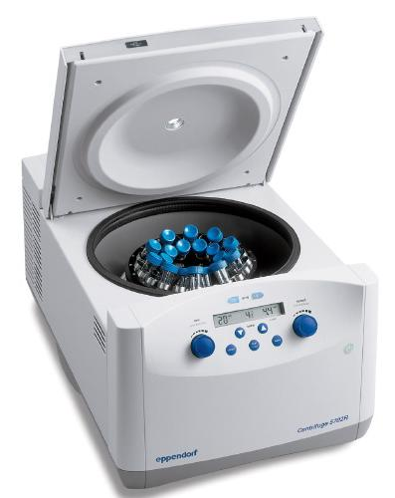
Site Equipment
Sites will need to supply the following items:
Processing
Crushed ice
Microcentrifuge tube rack
Calibrated pipettes and pipette tips
Centrifuge capable of maintaining 4°C
-80°C Freezer
Dry ice

Slide 7
Collection Protocol
Visit & Sample Type | BL | 12M | 24M
RNA, 2.5ml | 2 | 2 | 2
Plasma aliquots, 1ml | 6 | 6 | 6
Buffy Coat | 2 | 2 | 2
Whole Blood, 3ml | 2 | 2 | 2
CSF aliquots, 1ml | 10 | 10 | 10

Slide 8
Kit Ordering – Biosend.org

Slide 9
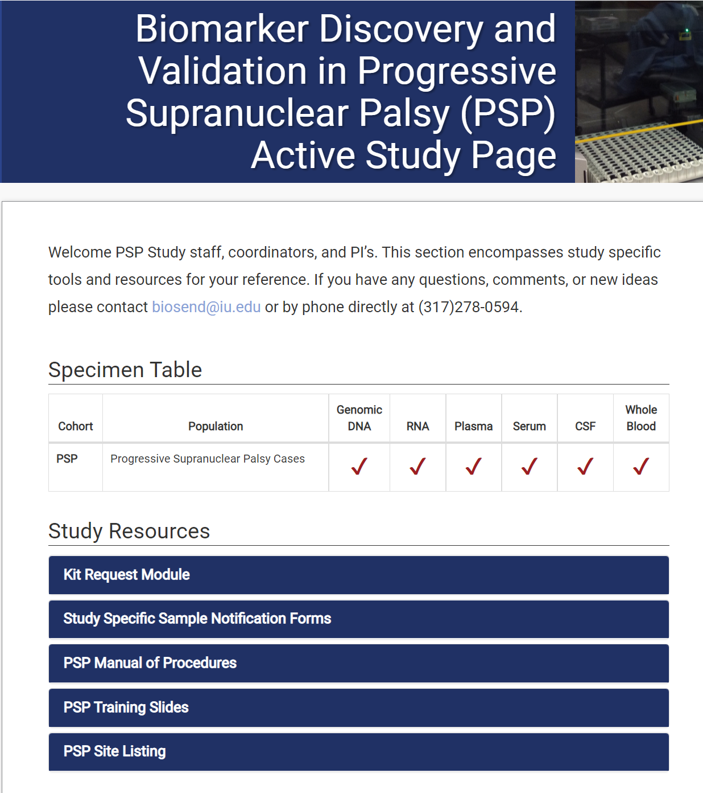
Kit Ordering
Direct link to kit ordering system:
http://kits.iu.edu/biosend/psp/

Slide 10
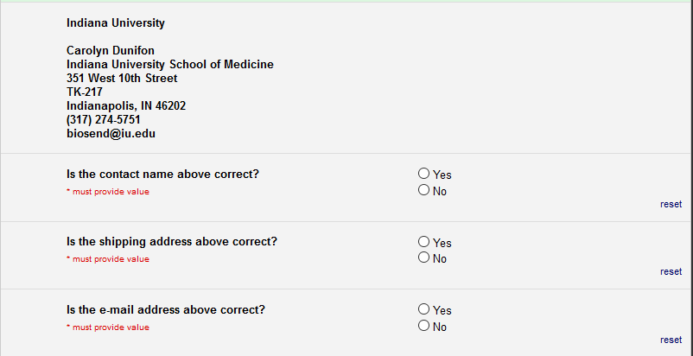
Confirm Shipping Info
Confirm site information:
Study site
Shipping address
Contact name
Email
Phone Number

Slide 11
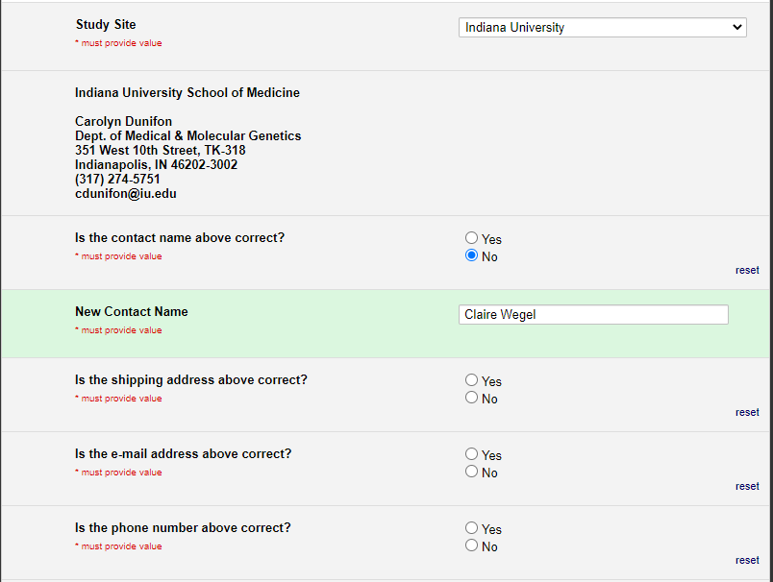
Kit Contents and Ordering
Select your site from the drop-down list
Verify contact information and update if needed
SPARX3 Kit Request Module

Slide 12
Kit Ordering
Multiple kit types available

Slide 13
Kit Ordering
BioSEND creates ST-Numbers for baseline kits
ST#s serve as the biorepository subject identifier
Enter kit quantity

Slide 14
Kit Ordering
Please note: the ST-Number provided in a BL kit can be used for any subject’s BL visit. This ST number is a subject identifier and will need to stay linked to the patient through the entirety of the study.

Slide 15
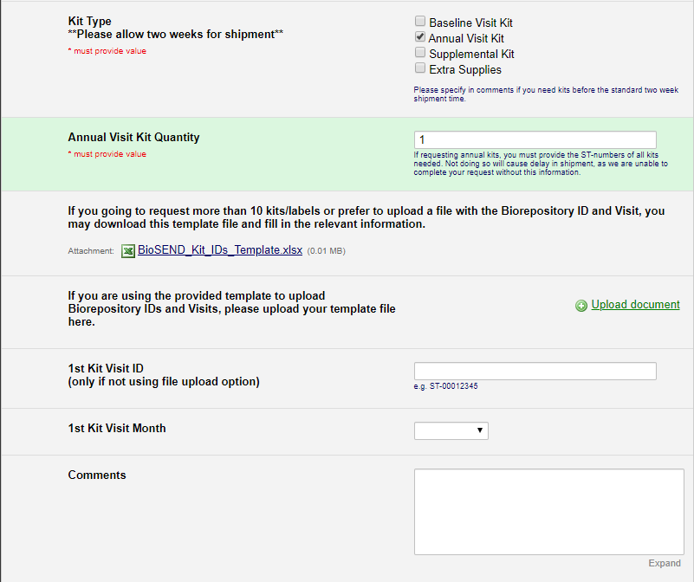
Kit Ordering
Please provide ST# and visit type for follow-up kits. We cannot complete your request without this information.

Slide 16
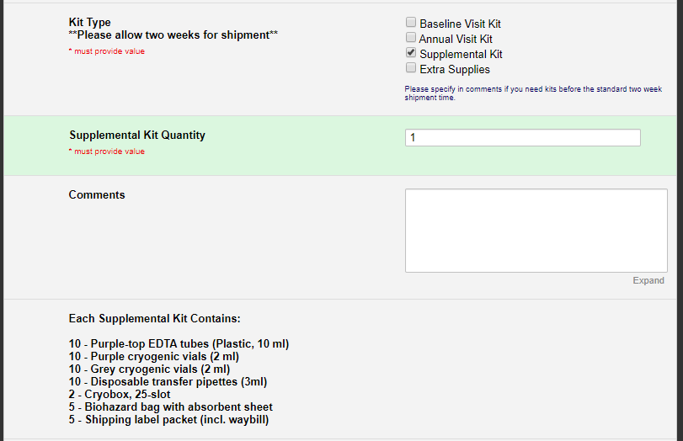
Kit Ordering
Contains a variety of extra kit components

Slide 17
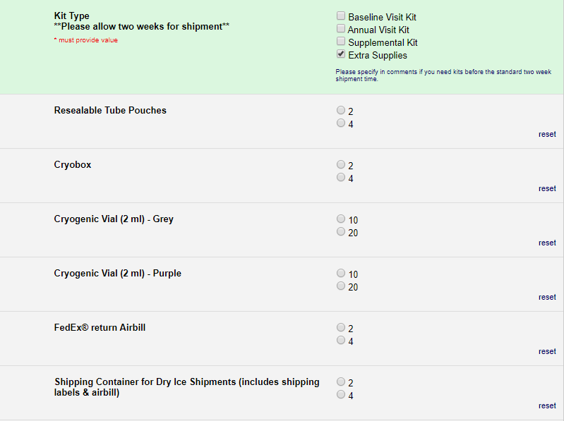
Kit Ordering
Allows you to choose specific supplies and particular quantities

Slide 18
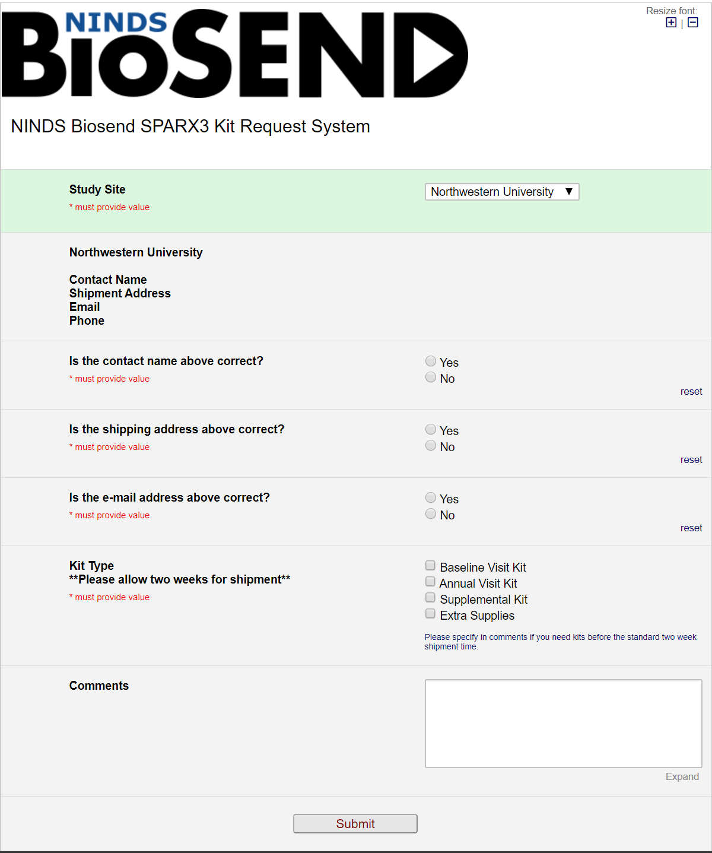
Kit Ordering
Click “Submit” to send order to BioSEND; staff will confirm receipt of your order
Please allow two week turn-around time for kit shipments
If urgent request needed, please note date needed by in comments and email BioSEND

Slide 19
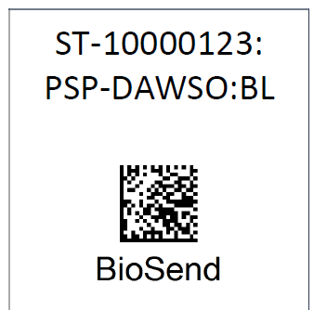
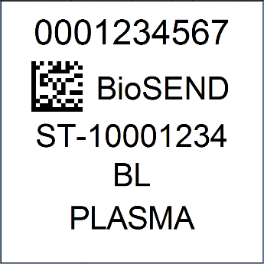
Sample Labelling
Labels are provided by Indiana University
Please check that all samples are properly labelled with correct specimen type and visit
Case Labels
Collection Tube Labels
Notes:
It can be difficult to stick the label on a cold or wet tube.

Slide 20
Sample Labelling – Case Labels
Subject Number
Study and Visit
Biorepository Name
Notes:
It can be difficult to stick the label on a cold or wet tube.

Slide 21
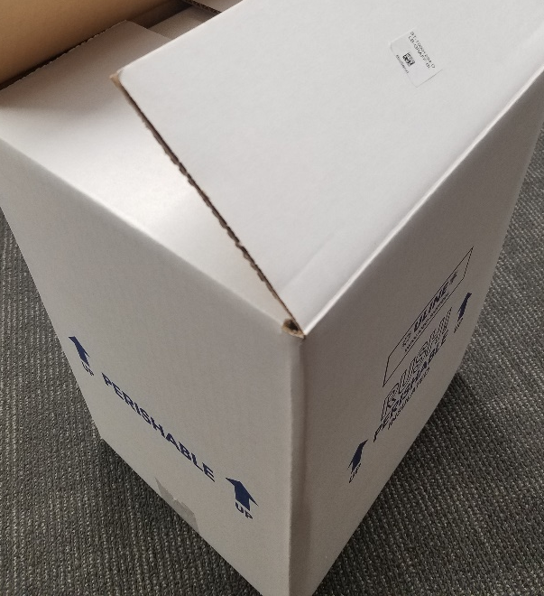
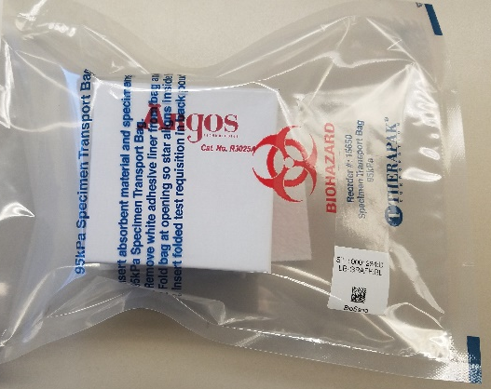
Sample Labelling – Case Labels
Case labels are placed:
On the biohazard bags
On the lid of frozen shippers

Slide 22
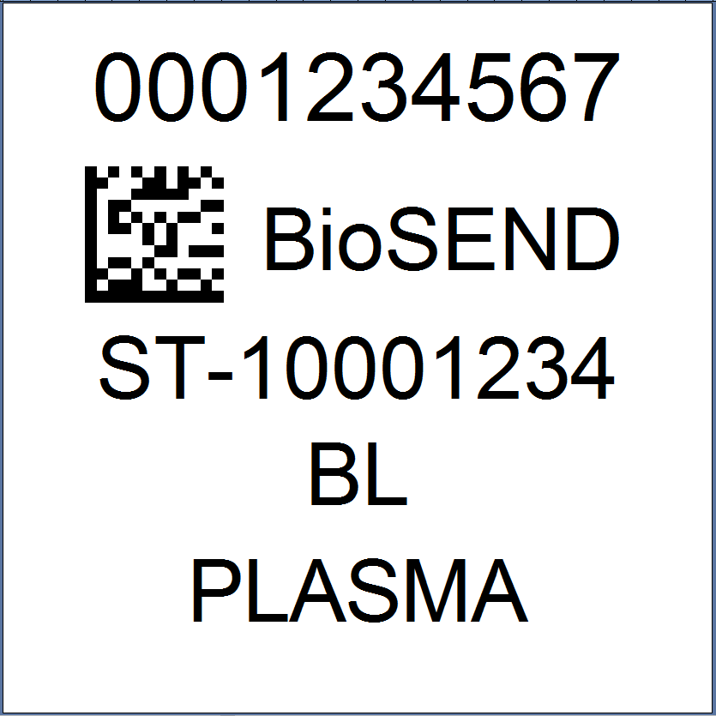
Sample Labelling – Collection Tube Labels
Unique Barcode
Biorepository Name
Subject Number
Visit
Sample Type
Notes:
It can be difficult to stick the label on a cold or wet tube.

Slide 23
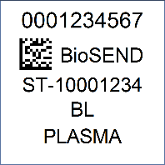
Sample Labelling – Collection Tube Labels
Incorrect
Correct
Notes:
It can be difficult to stick the label on a cold or wet tube.

Slide 24
Sample Collection and Processing
2 x 10ml EDTA for plasma and buffy coat
2 x 2.5ml RNA
2 x 3ml EDTA for whole blood
Blood Tube Draw Order
1
2
3

Slide 25
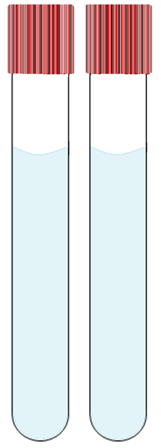
Sample Collection and Processing: RNA
Step One
Step Two
Step Three
Step Four
Step Five
PAXgene™ Tube
PAXgene™ Tube
Store tubes at room temperature.
Label prior to draw.
Collect blood into PAXGene™ tubes, allowing blood to flow for 10 seconds and ensuring blood flow has stopped.
Immediately after blood draw, invert tubes 8-10 times to mix samples.
Incubate tubes upright at room temperature for 24 hours.
After incubation period, freeze tubes upright at -80°C in a wire rack. Store at -80°C until shipment.

Slide 26
Sample Collection and Processing: Plasma & Buffy Coat
Step Three
Step Six
Step One
Step Two
Step Four
Step Five
Using a clean transfer pipet, aliquot 1.5 ml plasma into each purple cryotube.
Plasma
Plasma
Plasma
EDTA tube
EDTA tube
Label 6 purple cryotubes for plasma and 2 for buffy coat
Pre-chill cryotubes on wet ice for at least 5 minutes.
Store tubes at room temperature.
Label tubes with preprinted plasma labels prior to blood draw.
Collect blood in EDTA tubes, allowing blood to flow for 10 seconds and ensuring blood flow has stopped.
Immediately after blood draw, invert tubes 8-10 times to mix samples.
Within 30 minutes of blood draw, centrifuge sample at 1500 x g at 4C for 15 minutes.
Step Seven
Using a clean transfer pipet, collect the buffy coat (will have residual plasma and some RBCs included).
Transfer the buffy coat from each EDTA tube into a grey cryotube.
Store plasma & buffy coat at -80 until shipment.

Slide 27
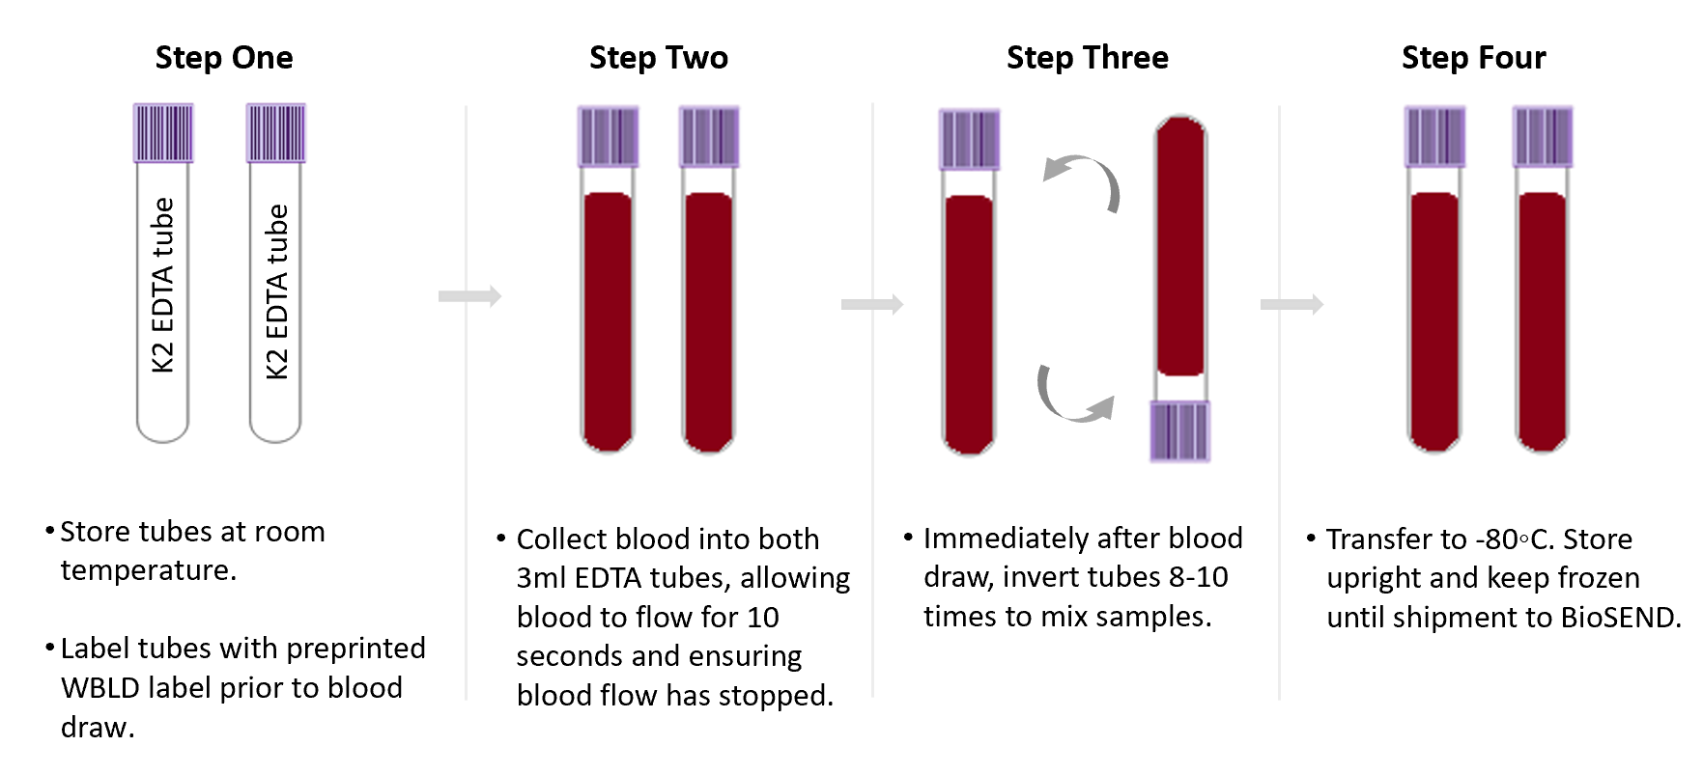
Sample Collection and Processing: Whole Blood

Slide 28
Blood Collection Troubleshooting
Most common issues with draw:
Store collection tubes at room temperature
Check expiration dates and keep extra tubes on hand
Avoid vigorous mixing of collected sample
Do not leave tubes uncentrifuged for longer than indicated time

Slide 29
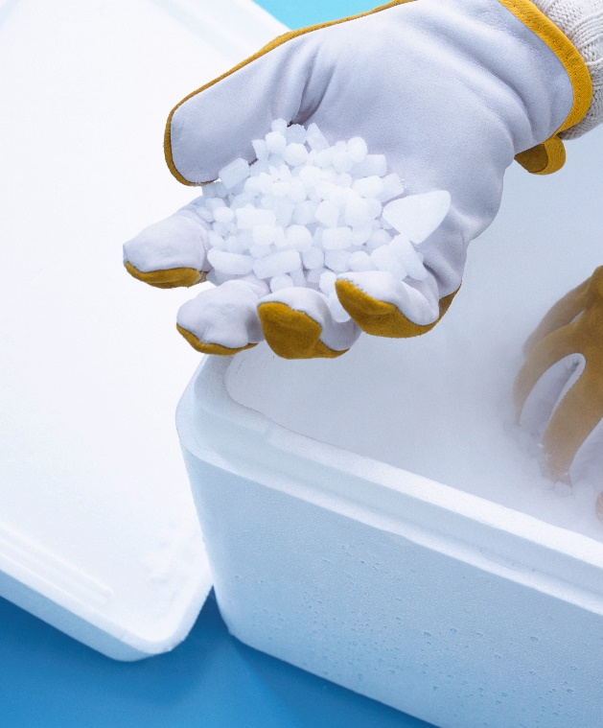
Shipping Samples: Frozen
Packing and Shipping Frozen Samples
Ship frozen samples on dry ice
Frozen samples should be shipped only Monday through Wednesday
Always fill carton to top with dry ice
Do not pack shipment until the day of pickup

Slide 30
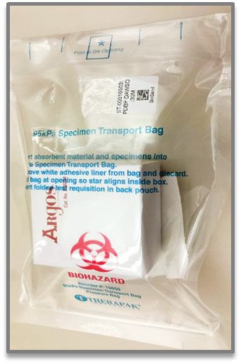
Shipping Samples: Frozen
Packing and Shipping Frozen Samples
Shippers use approx. 10lbs of dry ice
Place layer of dry ice in between cryoboxes
Notes:
We ask samples be shipped M-W only because Biosend does not have weekend hours. Shipments received to us on the weekend are bounced back into the courier system and we can’t guarantee the state in which the courier stores the samples. This mid-week cutoff allows for some courier delay in helping make sure those samples get here before the weekend.

Slide 31
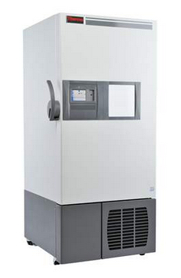
Shipping Frozen Samples
Hold packaged samples in a -80°C freezer until pickup.
Samples should be received at BioSEND within 2 weeks of collection.

Slide 32
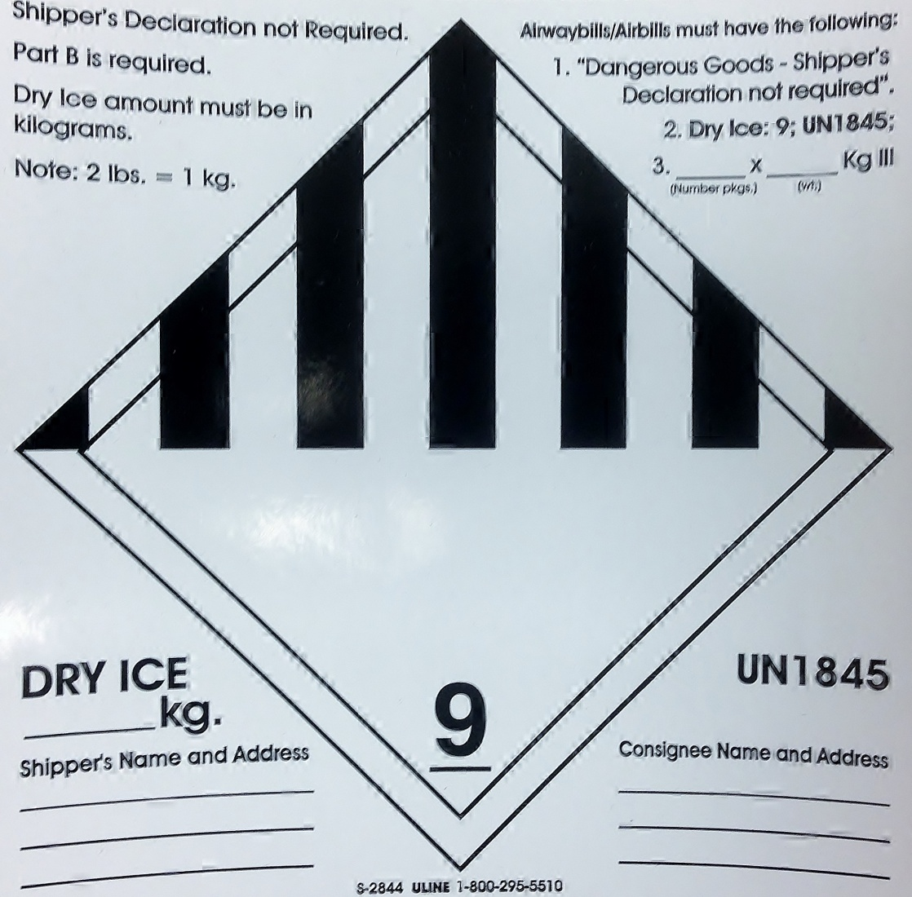
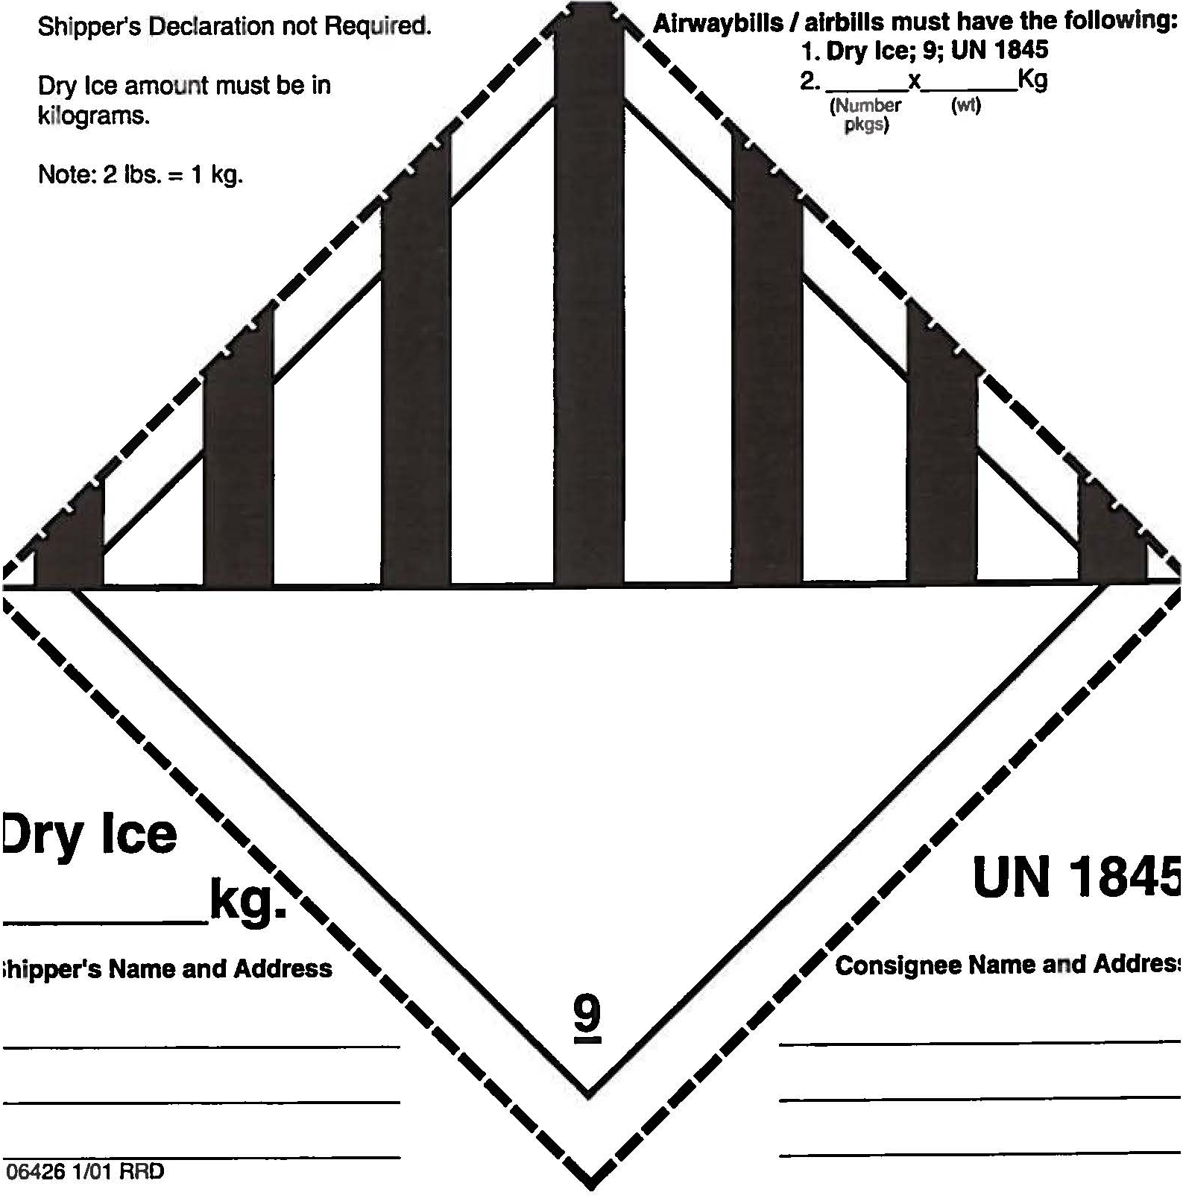
Shipping Samples
Class 9 Dry Ice Label should not be covered with other stickers and must be completed, or courier will reject/return your package!
Packing and Shipping Frozen Samples
Net weight of dry ice in kg
IU information and address
Your name & address
Notes:
As far as shipping supplies, we include some shipping labels including a Fragile label, a UN3373 (or category B) label, and a dry ice label. We highlight the dry ice label because there’s a few fields you need to complete before affixing the label to the package. Couriers are fairly strict about this label and will return or reject your package if not completed correctly, which increases the risk of the samples thawing.

Slide 33
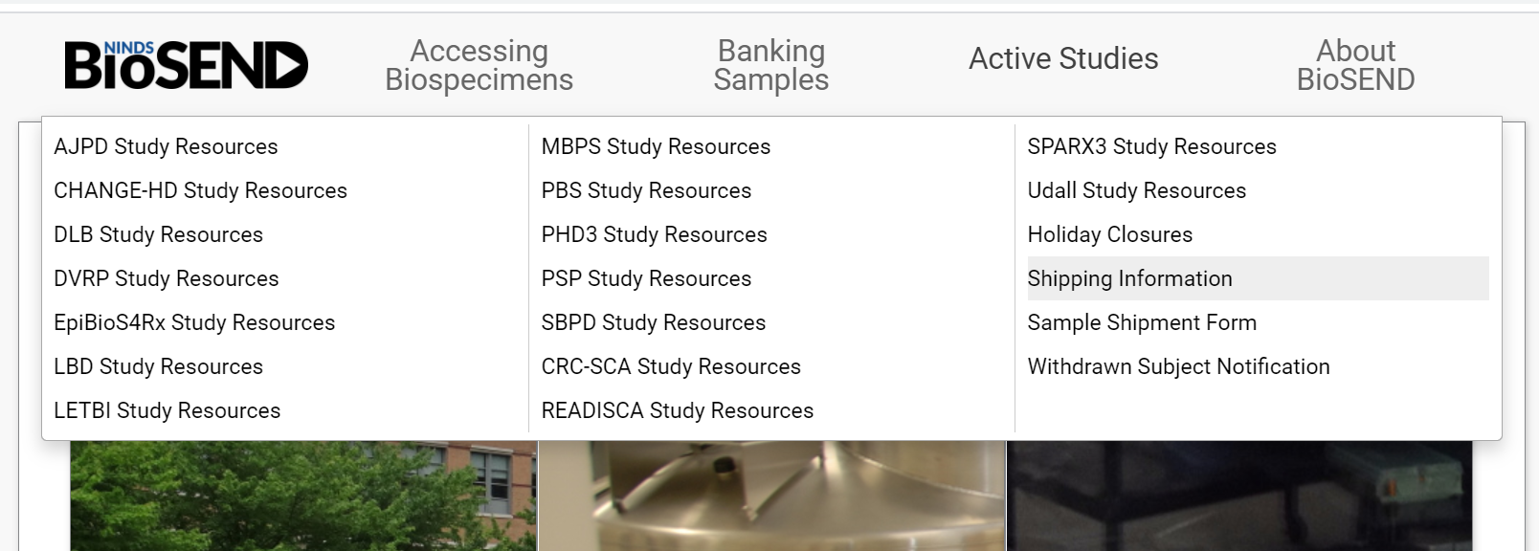
Shipping Samples
UPS resources available on BioSEND website
Notes:
Biosend does not provide airwaybills in kits. Instead, sites can access a UPS resource called “ShipExec Thin Client” to print off airwaybills as needed. The link to this system can be found on the Biosend website Shipping Information page.

Slide 34
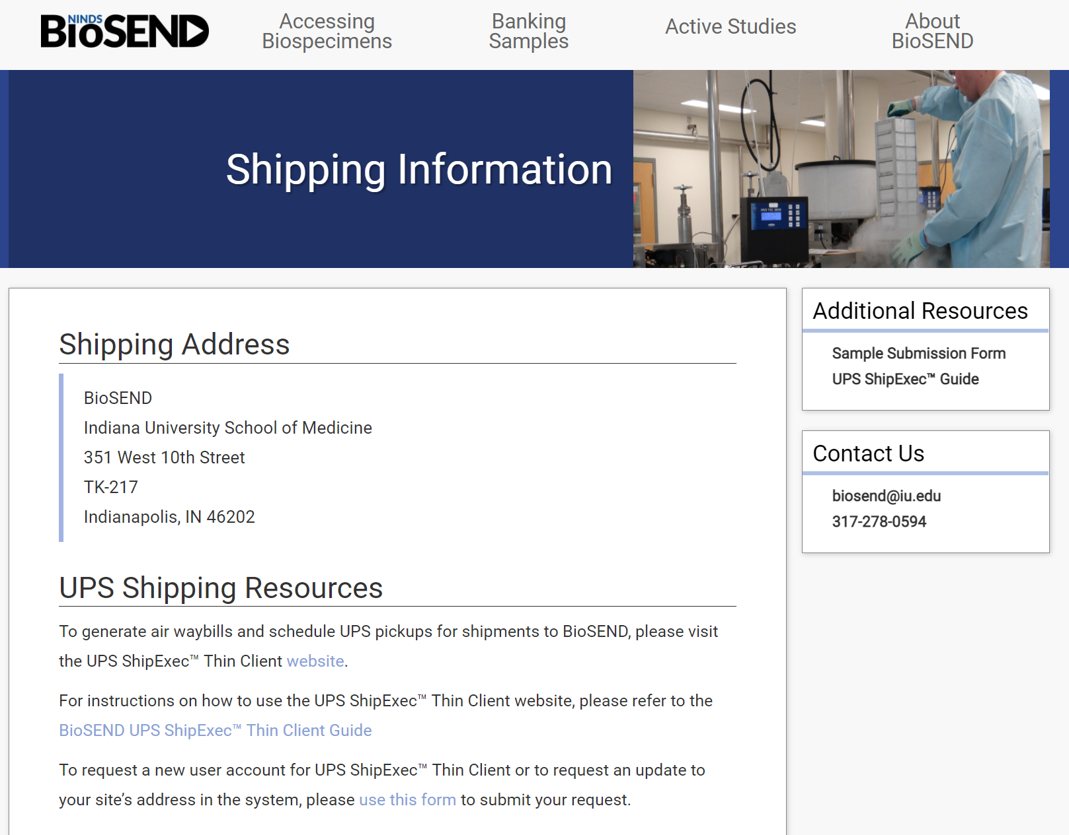
Shipping Samples
Links on this page to generate airwaybills, schedule pickups, request account, and view a guide for using the UPS ShipExec Thin Client system.
Notes:
In addition to the actual system, this page also includes a printed guide and video tutorial. Because those resources are available on the website, I don’t go over in depth on this call on how to use the system. However, please reach out to us if you have issues.

Slide 35
Shipping Samples: Notification
Please notify BioSEND ahead of shipment
Email biosend@iu.edu with copy of Sample Form and tracking number
OR use Online Sample form on biosend.org
Notes:
We ask for advance notification both so that we can give a heads up to our accessioning team and also so that if you shipped samples and we did NOT receive them, we know we need to follow-up with the courier to ensure samples get here safely.

Slide 36
Shipping Samples: Sample Form
Notes:
The study resources page contains a link to both the PDF sample form and web form. If you use the PDF version, you will have to email it to BioSEND ahead of shipment

Slide 37
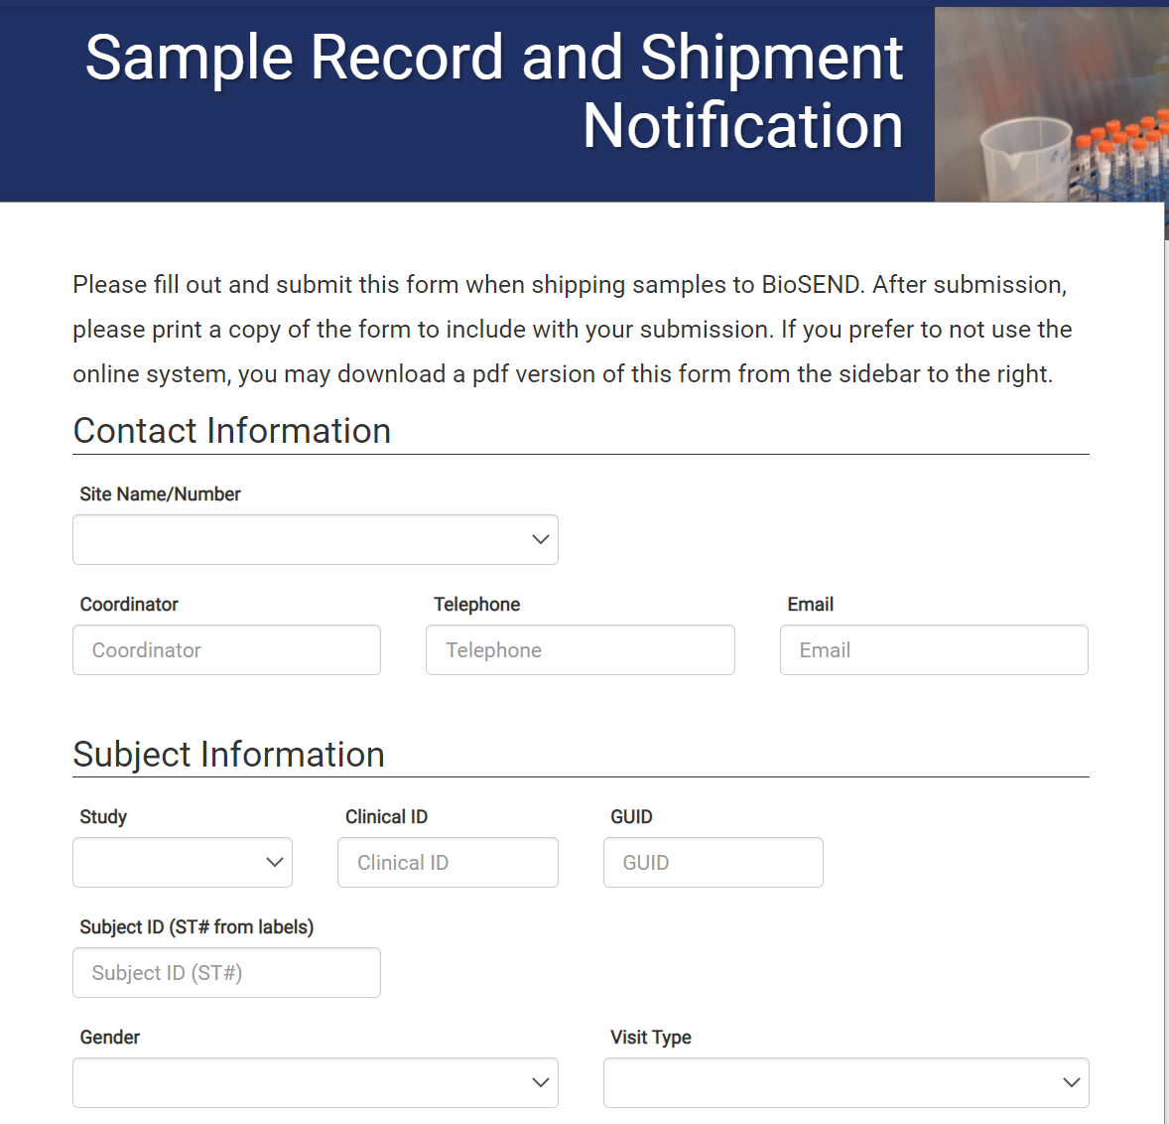
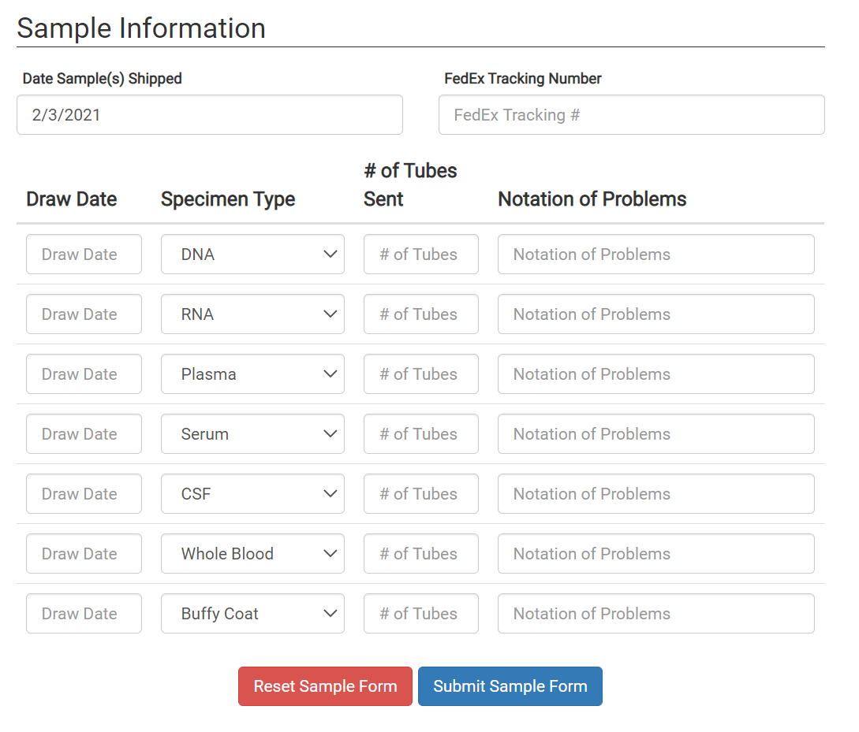
Shipping Samples: Sample Form
Notes:
This is the online version of the sample form. The sample form contact info should be someone at your site who can help resolve issues with the shipment if our lab has any questions. We also ask for basic subject and study visit to link the samples to clinical data. The rest of the sample form is a manifest of what’s included in the shipment that our lab uses to compare against the count and type of samples physically in the shipment.
Once you hit “submit” on the web form, a copy of this form is sent to the contact info you provide in “site contact” and to BioSEND, so there’s no need to do further notification. We don’t’ have a preference for the web form or PDF; whichever works best for your site is fine with us as long as we get notification.

Slide 38
Shipping Samples: Closures
Date | Holiday
January 1 | New Year's Day
3rd Monday in January | Martin Luther King, Jr Day
4th Monday in May | Memorial Day
June 19 | Juneteenth (observed)
July 4 | Independence Day (observed)
1st Monday in September | Labor Day
4th Thursday in November | Thanksgiving
4th Friday in November | Friday after Thanksgiving
December 25 | Christmas
Please also consider weather when shipping. UPS will post service updates on their webpage. Reach out to BioSEND if you an unsure if it is safe to ship.
Notes:
Note that we are closed to shipments on these days and also will not be able for questions/supply requests. We have extended closures at the end of the year to help keep our samples out of the fray of courier overload around the holidays. We close for shipments the week of Thanksgiving and the last two weeks of the year through the first business day of the New Year. We will add your email to our contact list that we use to send reminders about these extended closures. If you’re ever unsure about whether or not it’s okay to ship, you can reach out to us and we can make that call for you.

Slide 39
Contacts
Indiana University
General Questions/Shipment Notifications:
biosend@iu.edu
Biorepository Project Manager:
Claire Wegel
cwegel@iu.edu
Tel: 317.278.6158
Biorepository Clinical Research Coordinator:
Carolyn Dunifon
cdunifon@iu.edu
Tel: 317.274.5751
Notes:
Note that the BioSEND account is a good account if you’re not sure who to reach out to, as emails will go to all members of the BioSEND team. It’s also where you’ll want to send shipment notifications. You may also reach out to Carolyn and/or Claire directly for help

